Slide 1
TOPIC: Order of Operations
EQ: How Do I use the Order of Operations in Mathematics?
Year 7 Mathematics
Mrs Parlevliet

Slide 2
Things Required For This Lesson
Interactive Notebook
Ruler, Red Pen, Pencil, Pens, Scientific Calculator
Growth mindset
A new Contents and Glossary section

Slide 3
Contents
Glossary or Formula Page
Page
Date
Essential Question
24
7
30
Word or Formula
Definition or Example

Slide 4
Tasks
24
7
30
Topic
Essential Question
Questions
Notes
Summary
1
2

Slide 5
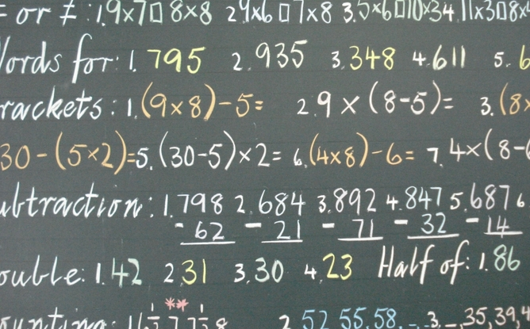
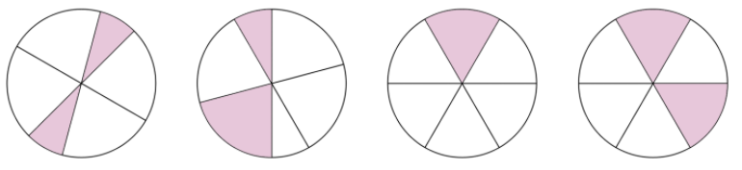

Five Questions (LHS)
Topic: Order of Operations
EQ: How do I use the Order of Operations in mathematics?
Date: XX/XX/2021
What is 20% of $30 correct to two decimal places?
On a certain night, half the moon is black, $\frac{3}{10}$ is grey and the rest of the moon is lit up brightly. What fraction of the moon is lit up brightly?
a) $\frac{1}{6}$ b) $\frac{1}{5}$ c) $\frac{8}{10}$ d) $\frac{10}{12}$
Round 280.3 cm to the nearest centimetre.
Solve $3+2×5$ without a calculator.
Which circle has one third shaded?
This Photo by Unknown Author is licensed uder CC BY-ND
Notes:
Answers
$6.00
$\frac{1}{5}$
280 cm
13
Fourth circle

Slide 6
24
7
30
Topic: Order of Operations
Date: XX/XX/2021
EQ: How do I use the Order of Operations in mathematics?
What is the Order of Operations?
The Order of Operations is the correct order of steps for evaluating a mathematical equation. It is also known as BIMDAS.
What is BIMDAS?
Order of Operations / BIMDAS
1. Brackets First
2. Indicies
3. Multiply and/or Divide
(from left to right)
4. Add or Subtract
(from left to right)
WICOR

Slide 7

Why does it MatTER?
Notes:
Class Discussion on why BIMDAS matters.
Standardised method of calculation so everyone arrives at the same answer
Real life examples where BIMDAS could apply
Medicine, (medication, x-rays, MRIs, etc)
Engineering (construction, electronics)
Chemistry
Architecture

Slide 8
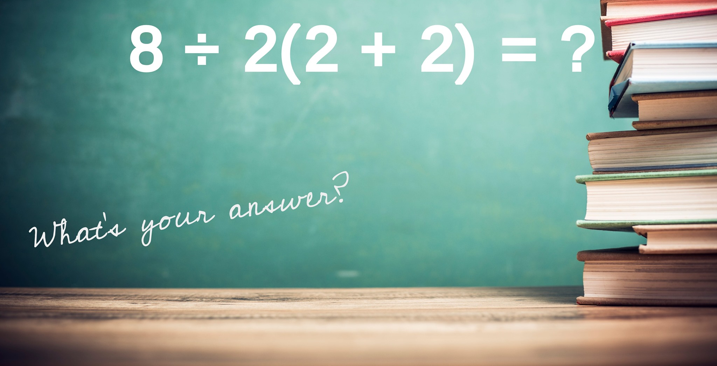
Notes:
Answer
$$8÷2\left(2+2\right)$$
$$=8÷2\left(4\right)$$
$$=8÷2×4$$
$$=4×4$$
$$=16$$
Role model working out and discuss the importance of working down the page when solving mathematical equations. This is the standard working out in Mathematics.

Slide 9
24
7
30
Topic: Order of Operations
Date: XX/XX/2021
EQ: How do I use the Order of Operations in mathematics?
WICOR

Slide 10
Practice (LHS)
Next will be some examples of how to use BIMDAS
A good tip is to underline the part you are going to do, then write the answer under your line, along with the rest of the sum.

Slide 11

B
I
M
D
A
S
(3
4)
x 2
+
x 2
=
7
=
14

Slide 12
B
I
M
D
A
S
3
3
4
x 2
+
+
=
8
=
11

Slide 13
B
I
M
D
A
S
4
4
x 3²
x
=
9
=
36

Slide 14
B
I
M
D
A
S
3
3
4
- 2
+
x 3
- 2
+
=
12
=
13

Slide 15
B
I
M
D
A
S
3
3
x
(5
2
x
2
- 2
- 3)
- 2
=
3
x
2
- 2
4
- 2
=
12
=
10

Slide 16
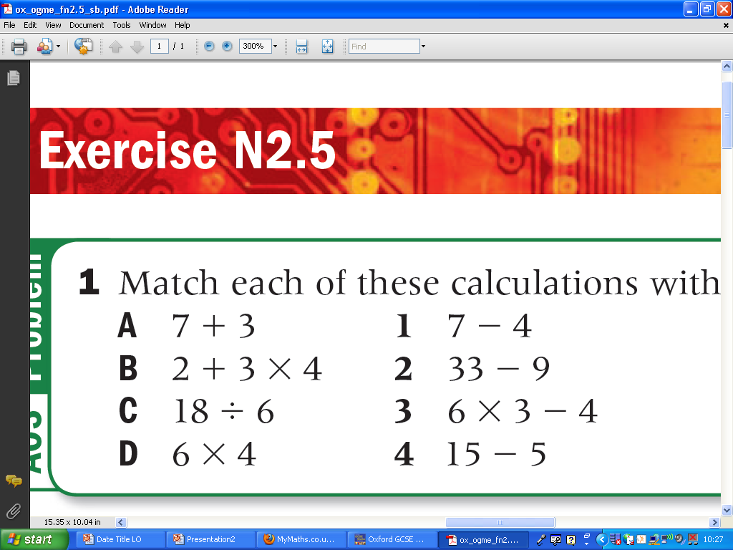
TASK: (LHS) Match each of these calculations with one that gives the same answer.
Hint: work all of them out and then match them up

Slide 17

Write Your Summary
Write a summary that answers the Essential Question: How do I use the Order of Operations in Mathematics?.
Include an example in your answer.
This Photo by Unknown Author is licensed under CC BY-SA

Slide 18
Evaluate the following:
5 x 3 – 4
50 ÷ 5 x 3
Put the brackets in for the following to work:
36 ÷ 4 + 5 = 4
3 + 4 x 7 – 5 = 14
Evaluate the following:
7² + (4 – 9)
(9 ÷ 3) x 4²

Slide 19
Evaluate the following:
5 x 3 – 4 = 11
50 ÷ 5 x 3 = 30
Put the brackets in for the following to work:
36 ÷ (4 + 5) = 4
(3 + 4) x (7 – 5) = 14
Evaluate the following:
7² + (4 – 9) = 44
(9 ÷ 3) x 4² = 48

Slide 20
What is the secret message?
Start 27 2 + 2 x 4 | T 10 8 – 3 x 2 | T 8 5x7+6x9 | O 12 5 x 2 + 7
R 7 37 – 4 x 8 | D 26 (5 – 2) x 5 | E 18 6 x (9 – 7) | R 60 7 x 8 - 9
H 2 2 x (4 + 5) | T 6 64÷(5 + 3) | S 47 9 x (5 – 2) | M 5 (4 + 5) x 8
A 72 48 ÷ (6+2) | E 89 4x(3+2)x3 | R 17 3x4+2x7 | E 15 11x3-2x13
Notes:
Start with the box marked start.
Find the answer to the problem, go to the box with this answer.
Write down the letter in this box. Etc until you get back to start.
What is the secret message?
THE ORDER MATTERS

